Slide 1
Facial Expression Recognition using Convolutional Neural Networks
[201046019] Swathi M Huttada Big Data and Data Analytics
[201046020] Rakshita Raghava Shetty Big Data and Data Analytics
[201046037] Bonagiri Sri Pranathi Big Data and Data Analytics

Slide 2
Agenda
Defining Facial Expressions
Objective and Applications
Datasets and Tools used
Defining Computer Vision and its Applications
Defining Convolutional Neural Network
Layers of CNN
Phases in CNN
Implementation
Results
References

Slide 3
Facial Expressions

Slide 4
Facial Expressions and why are they important?
Most non-verbal, universal form of body language.
Play a communicative role in interpersonal relations.
Effective during public speaking and oration.
Effective tool when speech is muted.
Communicative signal for the disabled.

Slide 5
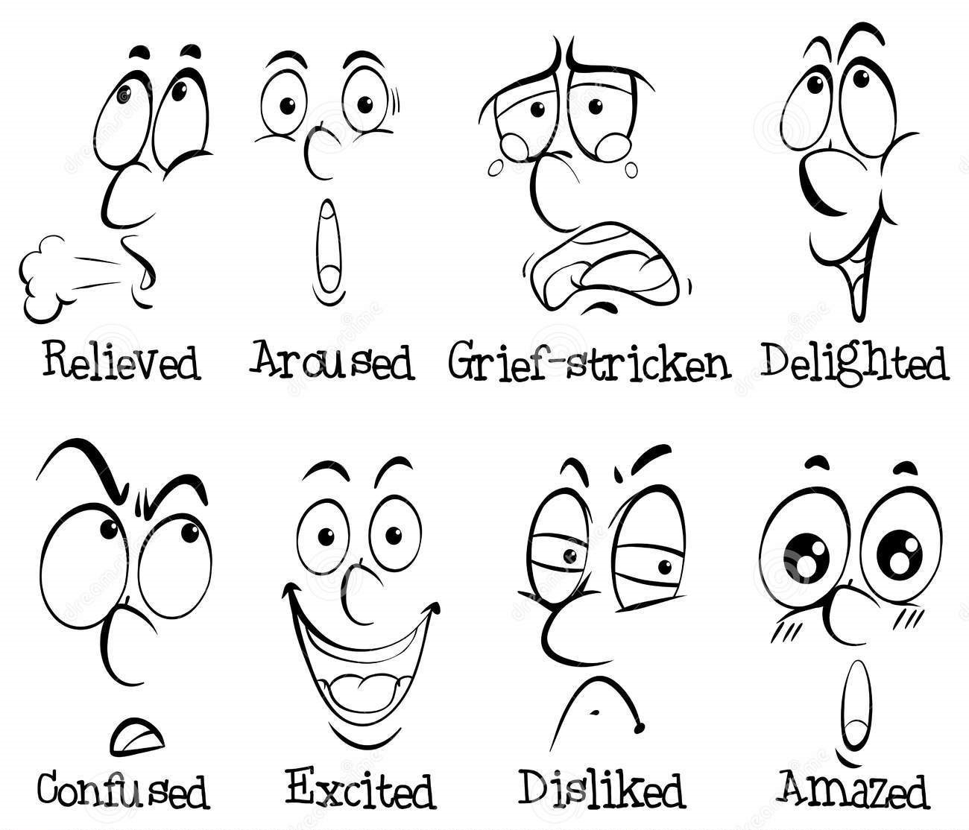
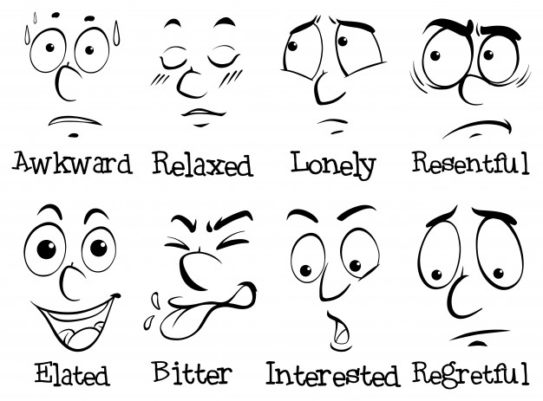
Examples of Facial Expressions
Notes:
Repl

Slide 6
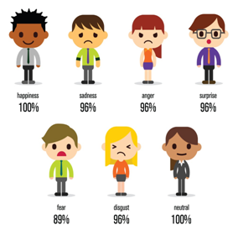
Objective
The objective is to implement Convolutional Neural Networks for classification of facial expressions.
Facial images dataset is classified into seven facial expression categories namely Happy, Sad, Surprise, Anger, Fear, Disgust, and Neutral.
Kaggle dataset is used to train and test the classifier.

Slide 7
Why do we need to detect facial expressions?
Emotional support
Mental health treatment
AI as medical assistants
Law enforcement
Advertising research
Personalization

Slide 8
Datasets and Tools used
Kaggle Facial Expression Recognition Challenge (FER2013) containing 48-by-48-pixel grayscale images 35887 facial images with facial expression labels.
Google Colab with runtime GPU.
Python 3.0, Numpy, Keras, SciPy, Pandas.
Tensorflow, TfLearn.
Computer Vision tools, such as OpenCV, SimpleCV.

Slide 9
Computer Vision

Slide 10
Computer Vision
Computer Vision is defined as a interdisciplinary scientific field of study that seeks to develop techniques to help computers “see” and understand the content of digital images such as photographs and videos. Typically, this involves developing methods that attempt to reproduce the capability of human vision.
Given a two-dimensional image, a computer vision system must recognize the present objects and their characteristics such as shapes, textures, colors, sizes, spatial arrangement, among other things, to provide a description as complete as possible of the image.

Slide 11
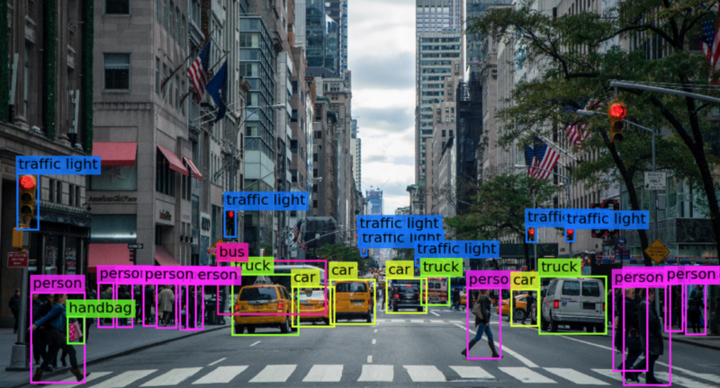

Slide 12
Where is Computer Vision used?
Transportation - Autonomous Driving, Driver Attentiveness Detection, Number Plate Recognition, Traffic Analytics and Safety, Collision Avoidance.
Health and Medicine - Cancer Detection, Cell Classification, Movement Analysis, Tumor Detection.
Agriculture and Farming - Defects in Agriculture, Plant Recognition, Animal Monitoring, Farm Automation.
Retail and Manufacturing - Customer Tracking, People Counting, Theft Detection, Waiting Time Analytics.
Sports - Sports Production, Player Tracking., Ball Tracking.

Slide 13
Convolutional Neural Network

Slide 14
Convolutional Neural Network
Convolution is one of the main building blocks of a CNN. The term convolution refers to the mathematical combination of two functions to produce a third function. It merges two sets of information.
A Convolutional Neural Network/ConvNet is a feed-forward neural network that is generally used to analyze visual images by processing data with grid-like topology. It is used to detect and classify objects in an image.

Slide 15
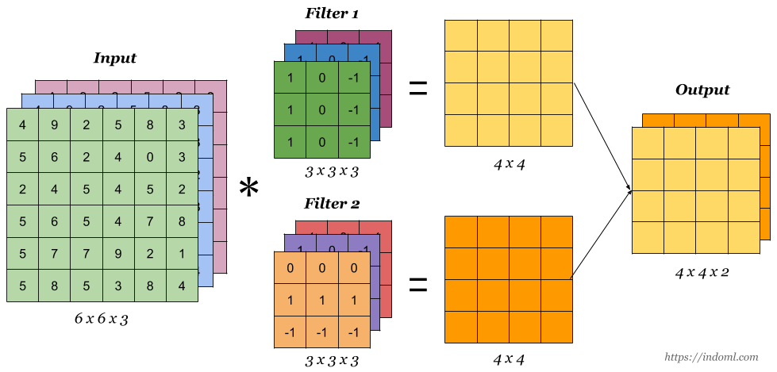
Diagrammatic representation of Convolution Process

Slide 16
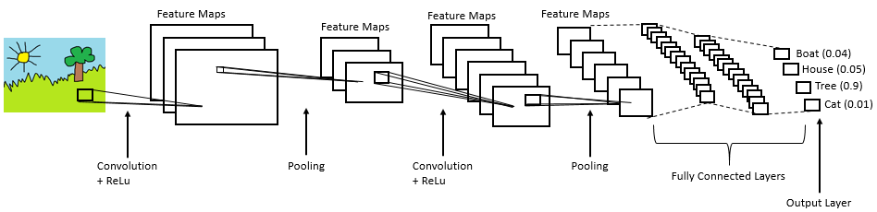
How do CNN’s work?

Slide 17
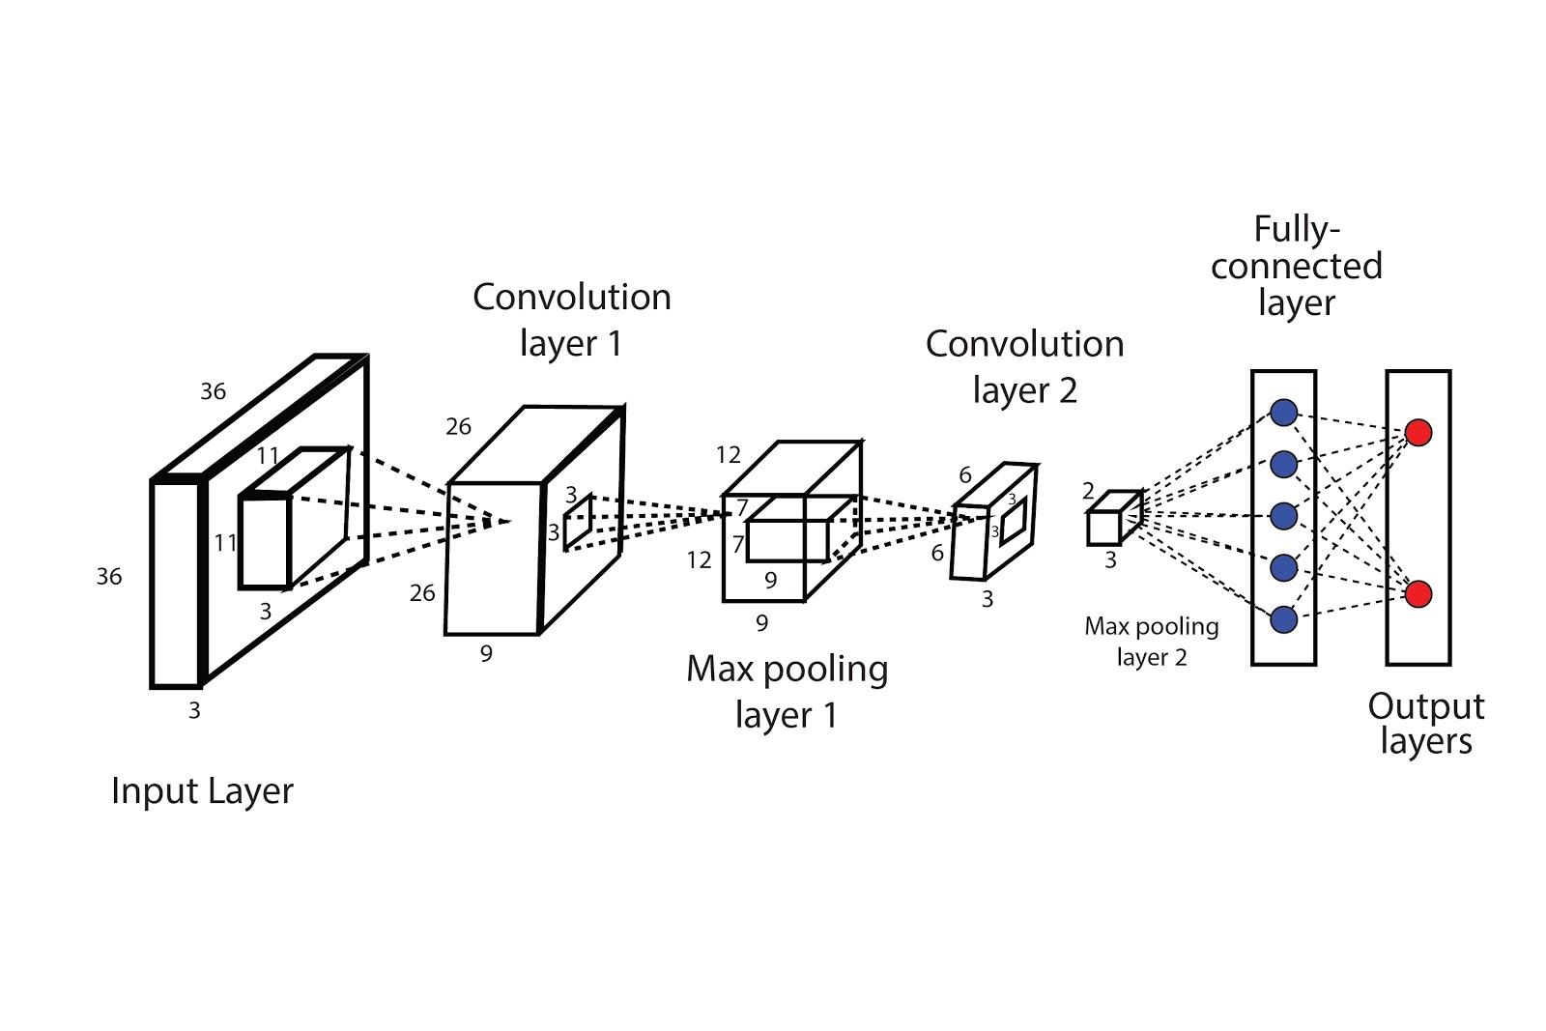
Layers in a CNN

Slide 18
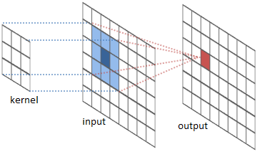
Convolutional Layer
A filter/kernel, is passed over the image, viewing a few pixels at a time (for example, 3X3 or 5X5). The convolution operation is a dot product of the original pixel values with weights defined in the filter. The results are summed up into one number that represents all the pixels the filter observed.

Slide 19
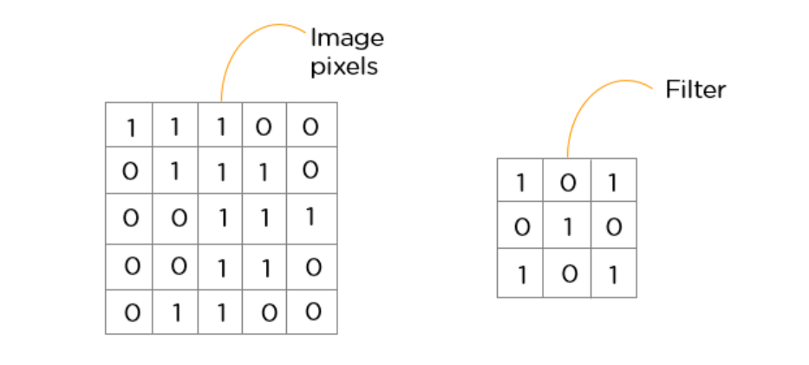
Feature Extraction - Convolution is performed on the input data with the use of a filter/kernel to produce a feature map.
Kernel - or mask is a small matrix used for blurring, sharpening, embossing, edge detection, and more. This is accomplished by doing a convolution between a kernel and an image.

Slide 20
Filter (the green square) is sliding over our input (the blue square) and the sum of the convolution goes into the feature map (the red square).
The size of this filter is 3x3.

Slide 21
Stride is the size of the step the convolution filter moves each time. A stride size is usually 1, meaning the filter slides pixel by pixel.
The animation shows stride size 1 in action.

Slide 22
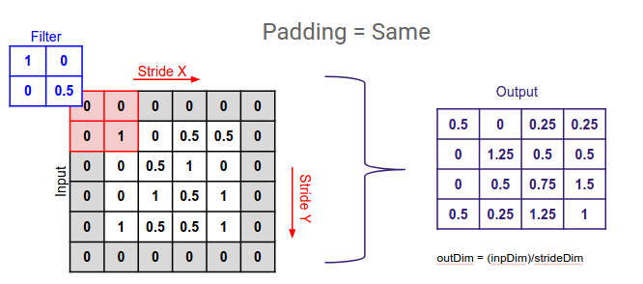
Padding - the size of the feature map is always smaller than the input, to prevent our feature map from shrinking, we,
Pad the picture with zeros (zero-padding) so that it fits.
Drop the part of the image where the filter did not fit. This is called valid padding which keeps only valid part of the image.

Slide 23
When using a CNN, the four important parameters we have to decide on are:
the kernel size
the filter count
stride
padding

Slide 24
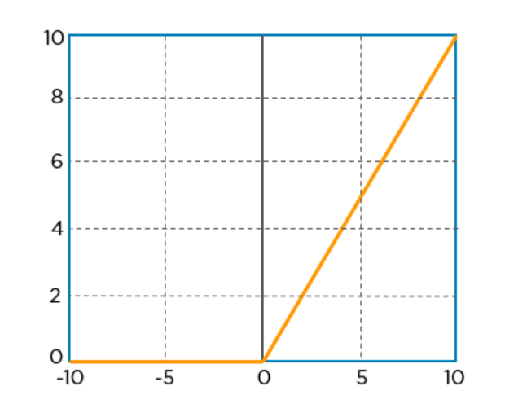
ReLu (Rectified Linear Unit) Layer
The convolution layer generates a matrix that is much smaller in size than the original image. This matrix is run through an activation layer, which introduces non-linearity to allow the network to train itself.
A(x) = max(0,x)

Slide 25
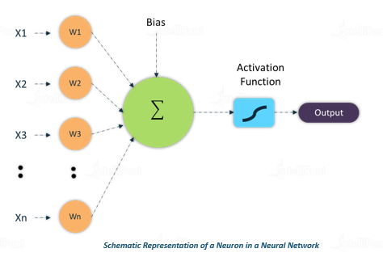
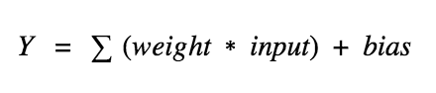
Weights and Biases
Weights - decides how much influence the input will have on the output.
Biases - bias unit guarantees that even when all the inputs are zeros there will still be an activation in the neuron.

Slide 26
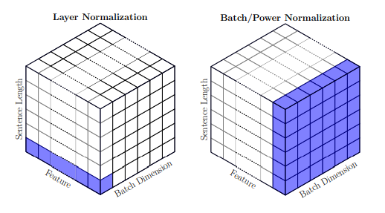
Normalisation is the process of subtracting the mean and dividing by the standard deviation.
Batch Normalisation helps making the network output more stable predictions, speeds up training by an order of magnitude.

Slide 27
Pooling Layer
Pooling is the process of further downsampling and reducing the size of the matrix. A filter is passed over the results of the previous layer and selects one number out of each group of values. This allows the network to train much faster, focusing on the most important information in each feature of the image.

Slide 28
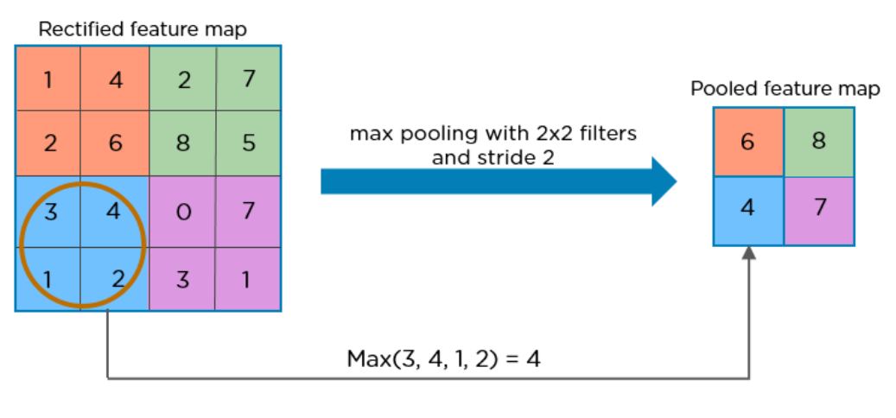
The three types of pooling operations are:
Max pooling: The maximum pixel value of the batch is selected.
Min pooling: The minimum pixel value of the batch is selected.
Average pooling: The average value of all the pixels in the batch is selected.

Slide 29
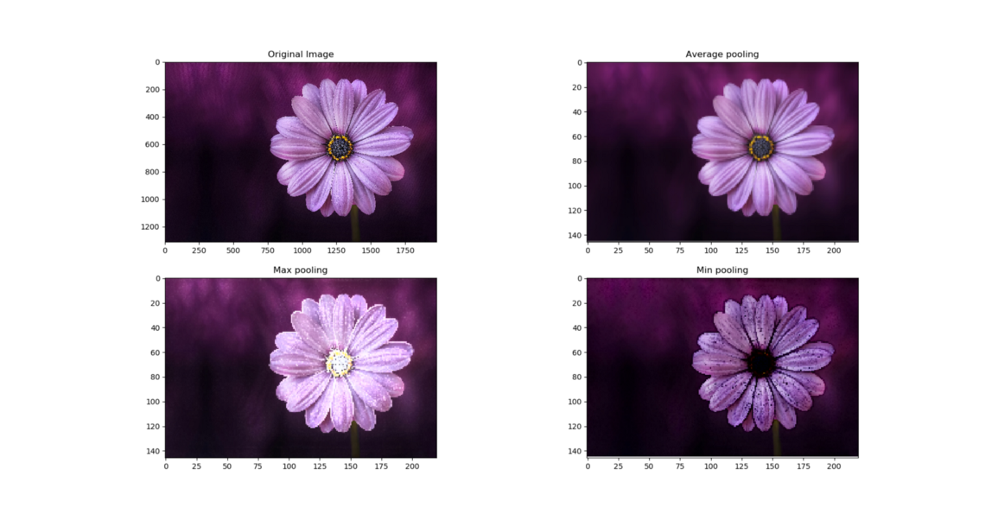
Average, Max and Min pooling of size 9x9 applied on an image

Slide 30
Fully Connected Layer
Its input is a one-dimensional vector representing the output of the previous layers. Its output is a list of probabilities for different possible labels attached to the image (e.g. dog, cat, bird). The label that receives the highest probability is the classification decision.

Slide 31
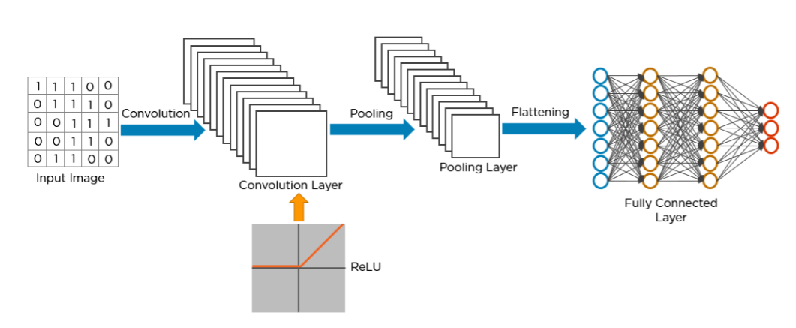
Diagrammatic Representation of Fully Connected Layer

Slide 32
Classification
After feature extraction we need to classify the data into various classes, this can be done using a fully connected neural network.
But we generally end up adding FC layers to make the model end-to-end trainable. The fully connected layers learn a function between the high-level features given as an output from the convolutional layers.

Slide 33
Training
In order to reach the optimal weights and biases that will give us the desired output, we will have to train our neural network.
Neural network will have to undergo many epochs or iterations to give us an accurate prediction. We specify a learning rate for the model. The learning rate is the multiplier to update the parameters. It determines how rapidly they can change.

Slide 34
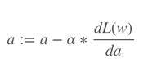
Learning Rate
:= means that this is a definition, not an equation or proven statement.
a is the learning rate called alpha
dL(w) is the derivative of the total loss with respect to our weight w
da is the derivative of alpha

Slide 35
Phases in CNN
Training Phase - The machine learns all the features from the input dataset using certain algorithms and stores it in a database as a model.
Test Phase - This learned information/model of the machine is then again tested for further validations.

Slide 36
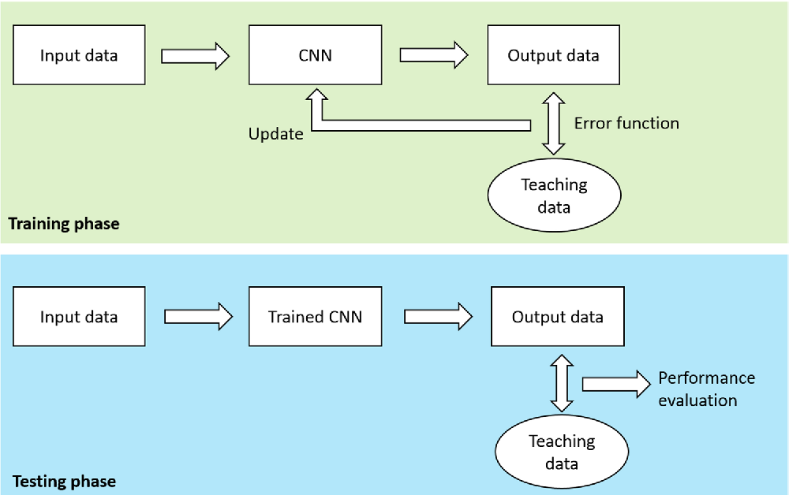

Slide 37
Implementation
Importing datasets and libraries - Tensorflow, Tflearn, Numpy, Keras, opencv 3,scipy, os, sys, itertools, cv2, pandas, skimage, Anaconda Environment.
Kaggle Facial Expression Recognition Challenge (FER2013) - 35887 facial images, pre-cropped, 48-by-48-pixel grayscale images of faces each labelled with one of the 7 emotion classes: anger, disgust, fear, happiness, sadness, surprise, and neutral.
Train the data - We design the CNN through which we will pass our features to train the model and eventually test it using the test features. We trained every modification for 100 epochs of fixed batch size 64.

Slide 38
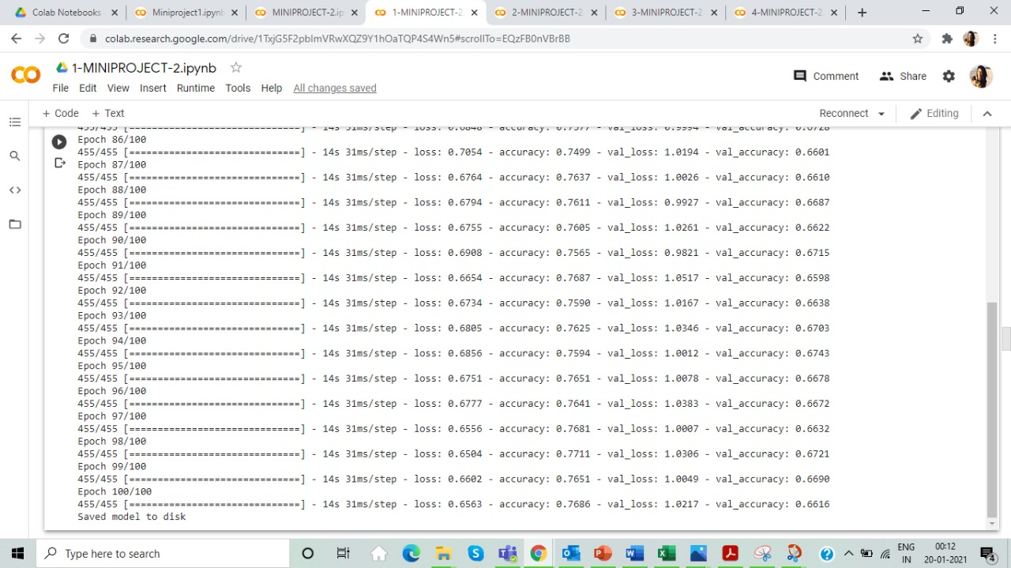

Slide 39
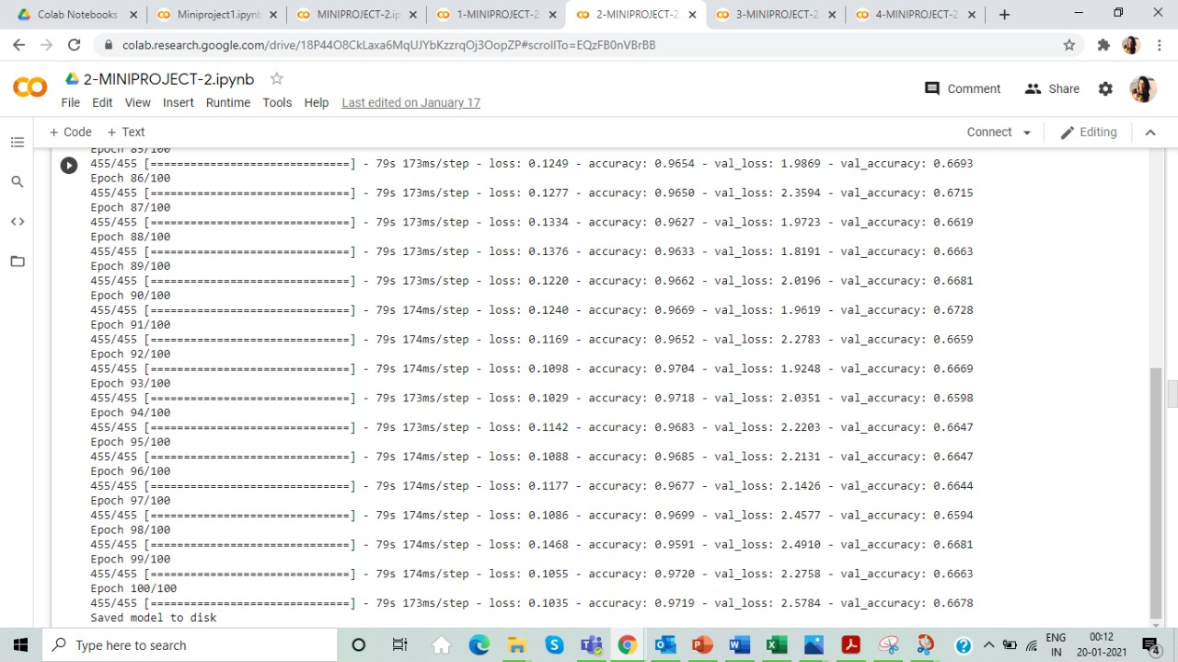

Slide 40
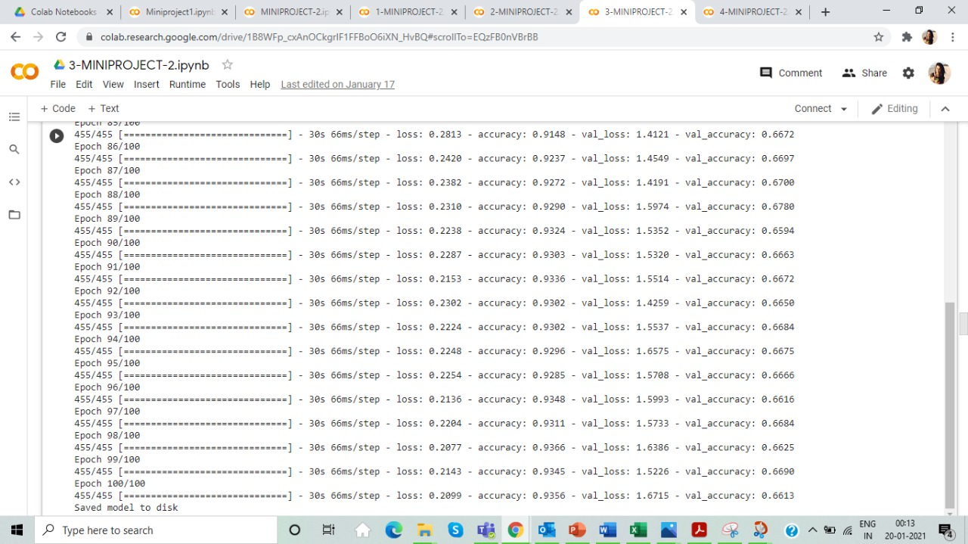

Slide 41
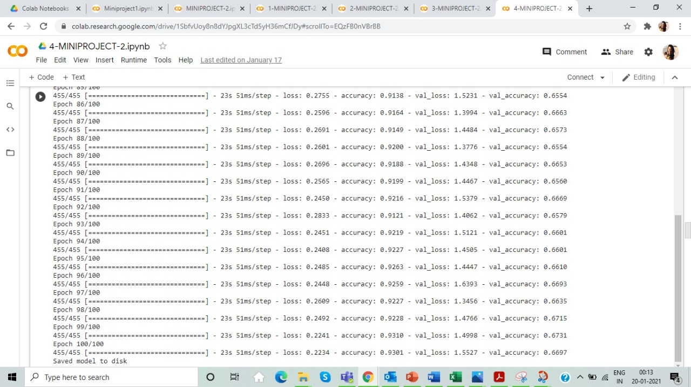

Slide 42
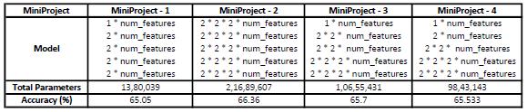
Result
We have designed the CNN model and started training our data accordingly to the specific parameters and evaluated them. We observed that we have have obtained an accuracy 66.36 %. We implemented this model and we rightly classify few images and were few misclassifications while detecting facial expression of the person in the image scene using CNN learning algorithms.

Slide 43
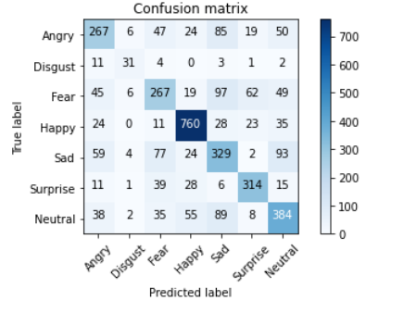

Slide 44
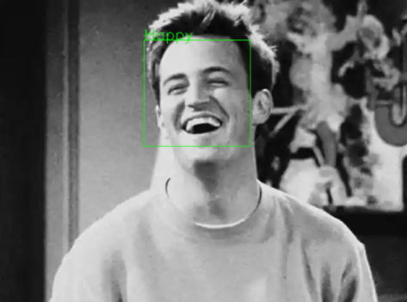
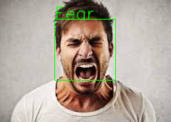
Correctly Classified Image
Misclassified Image

Slide 45
References
[1] Shan, C., Gong, S., & McOwan, P. W. (2005, September). Robust facial expression recognition using local binary patterns. In Image Processing, 2005. ICIP 2005. IEEE International Conference on (Vol. 2, pp. II-370). IEEE.
[2] Chibelushi, C. C., & Bourel, F. (2003). Facial expression recognition: A brief tutorial overview. CVonline: On-Line Compendium of Computer Vision, 9.
[3] "Convolutional Neural Networks (LeNet) – DeepLearning 0.1 documentation". DeepLearning 0.1. LISA Lab. Retrieved 31 August 2013.

Slide 46
[4] Simonyan, Karen, and Andrew Zisserman. ”Very deep convolutional networks for large-scale image recognition.” arXiv preprint arXiv:1409.1556 (2014).
[5][Fer2013] Dataset from Kaggle [https://www.kaggle.com/c/challenges-in-representation- learning-facial-expression- recognition-challenge/data]
[6] C. Zor, “Facial expression recognition,” Master’s thesis, University of Surrey, Guildford, 2008.

Slide 47
[7] Suwa, M.; Sugie N. and Fujimora K. A Preliminary Note on Pattern Recognition of Human Emotional Expression, Proc. International Joint Conf, Pattern Recognition, pages 408-410, 1978
[8] Recognizing action units for facial expression analysis YI Tian, T Kanade, JF Cohn IEEE Transactions on pattern analysis and machine intelligence 23 (2), 97-115
[9] Raghuvanshi, Arushi, and Vivek Choksi. "Facial Expression Recognition with Convolutional Neural Networks." Stanford University, 2016
[10] Alizadeh, Shima, and Azar Fazel. "Convolutional Neural Networks for Facial Expression Recognition." Stanford University, 2016

Slide 48
Thank You

